Slide 1


Slide 2
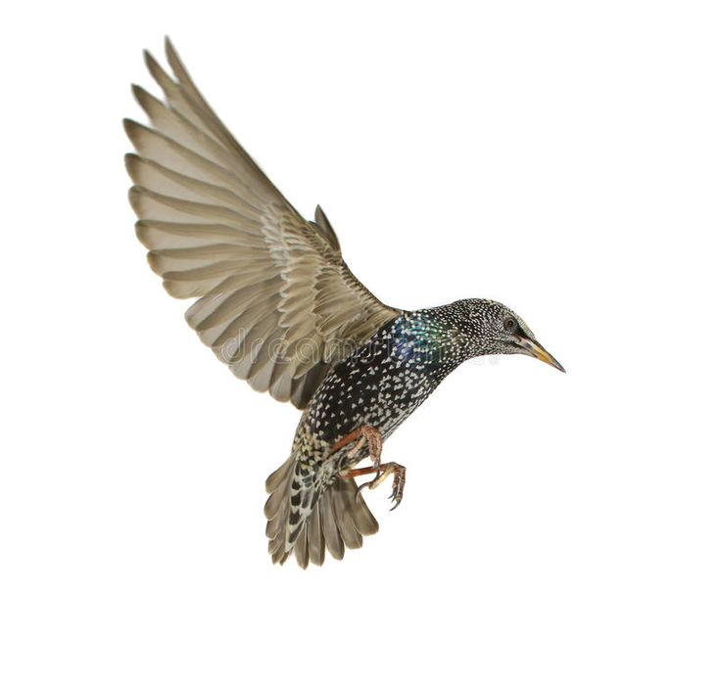
WEEK 2: SYSTEM THINKING THROUGH SPECULATIVE DESIGN (STSD)
COMP0184
January 2025
Notes:
in depth understanding of emerging user interfaces and technologies.

Slide 3
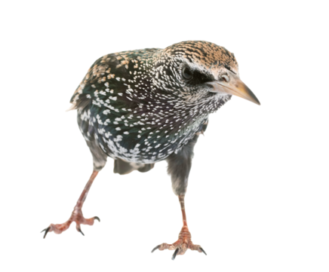
How was your lecture?!

Slide 4
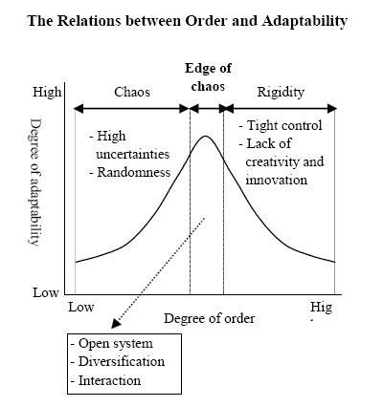
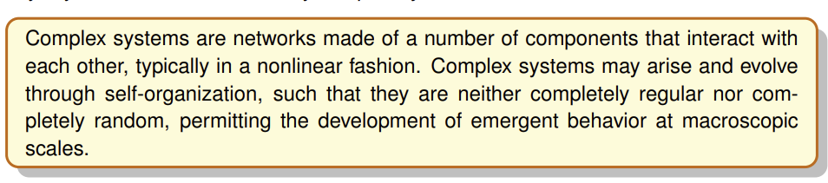
COMPLEXITY SCIENCE
Notes:
Here is the same content expressed plainly, without formatting, and with an explicit description of what happens on either side of the edge of chaos for each phenomenon.
The edge of chaos is the regime between excessive order (stasis, rigidity) and excessive disorder (randomness, noise). Systems there are flexible without losing coherence.
In cognition and neuroscience, brain dynamics near the edge of chaos allow learning and adaptability. If the system is too ordered, neural activity becomes rigid and repetitive, leading to poor learning and inflexibility. If it is too chaotic, activity becomes noisy and unstable, preventing reliable memory or coordinated thought.
In biology and evolution, genetic regulatory networks near the edge of chaos support evolvability. On the ordered side, organisms are robust but brittle, meaning mutations are mostly harmful and innovation is rare. On the chaotic side, mutations disrupt essential functions, leading to nonviable organisms. Near the edge, small changes can produce useful variation without destroying the organism.
In morphogenesis and development, pattern formation emerges at the edge of chaos. Too much order produces uniform or frozen structures with little differentiation. Too much chaos yields disorganized growth with no stable form. Near the edge, coherent but diverse spatial patterns arise.
In collective behavior such as ant colonies or flocks, coordination emerges without central control near the edge of chaos. In overly ordered systems, behavior is rigid and slow to adapt to new conditions. In overly chaotic systems, individuals act independently and no collective structure forms. Near the edge, groups are coherent yet responsive.
In ecology, ecosystems near the edge of chaos show high resilience. On the ordered side, ecosystems are stable but fragile, so disturbances can cause sudden collapse. On the chaotic side, populations fluctuate wildly and species fail to persist. Near the edge, ecosystems absorb shocks while reorganizing effectively.
In computation and artificial life, systems near the edge of chaos maximize information processing. In the ordered regime, computation is trivial and repetitive, storing information but not transforming it. In the chaotic regime, computation is unreliable because information is quickly lost. Near the edge, information can be stored, transmitted, and transformed efficiently.
In learning systems and evolutionary algorithms, performance peaks near the edge of chaos. Too much order causes premature convergence and stagnation. Too much randomness prevents accumulation of improvements. Near the edge, exploration and exploitation are balanced.
In economics and social systems, innovation emerges near the edge of chaos. Overly ordered systems become bureaucratic and resistant to change. Overly chaotic systems are unstable and fail to sustain cooperation. Near the edge, novelty arises without systemic breakdown.
In physics and complex systems, self-organized criticality occurs near the edge of chaos. On the ordered side, disturbances fade quickly and the system is inert. On the chaotic side, disturbances cascade uncontrollably. Near the edge, events of all sizes occur, allowing adaptive reconfiguration.

Slide 5
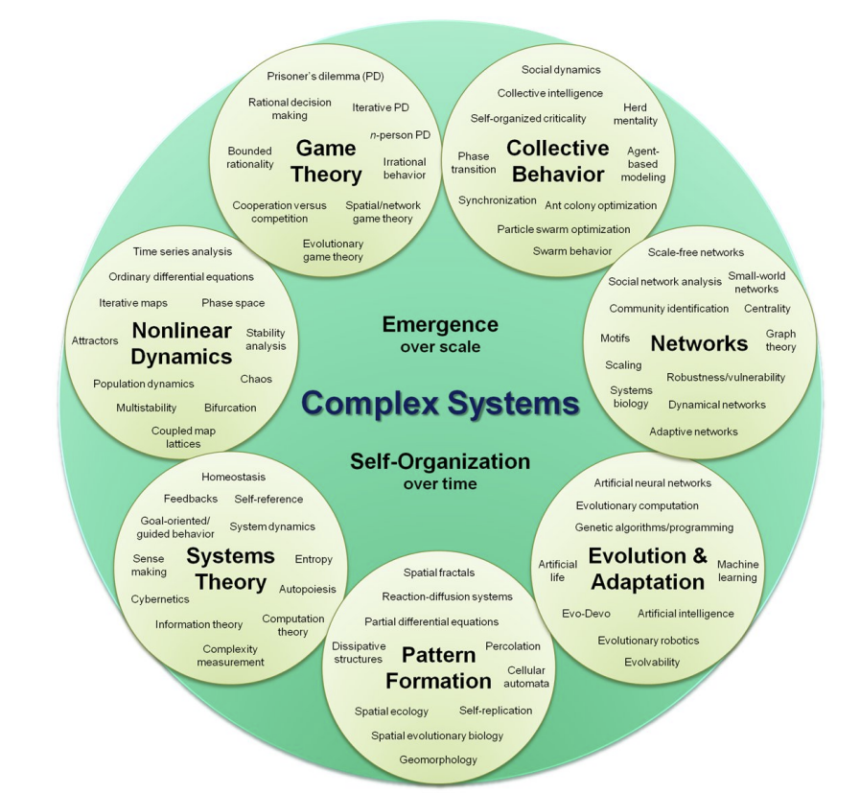
COMPLEXITY SCIENCE

Slide 6
AIMS FOR TODAY
Dynamical systems
Modelling
Analysing
Systems with a small number of variables

Slide 7
DYNAMICAL SYSTEMS

Slide 8
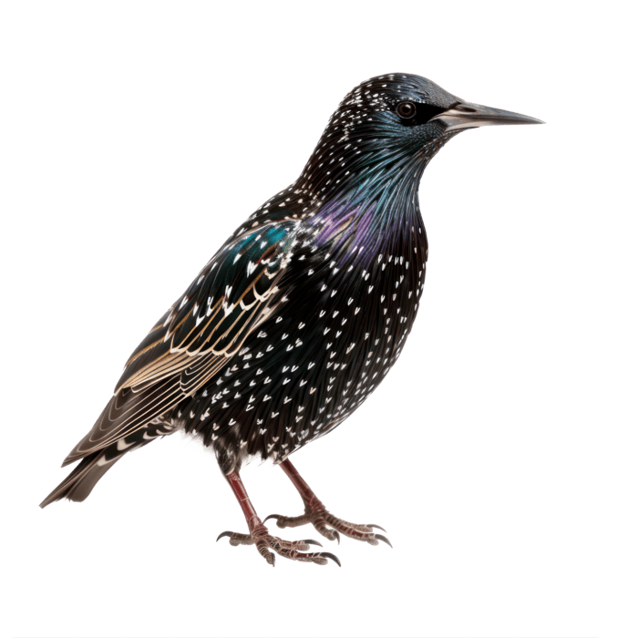
QUESTIONS?

